Slide 1
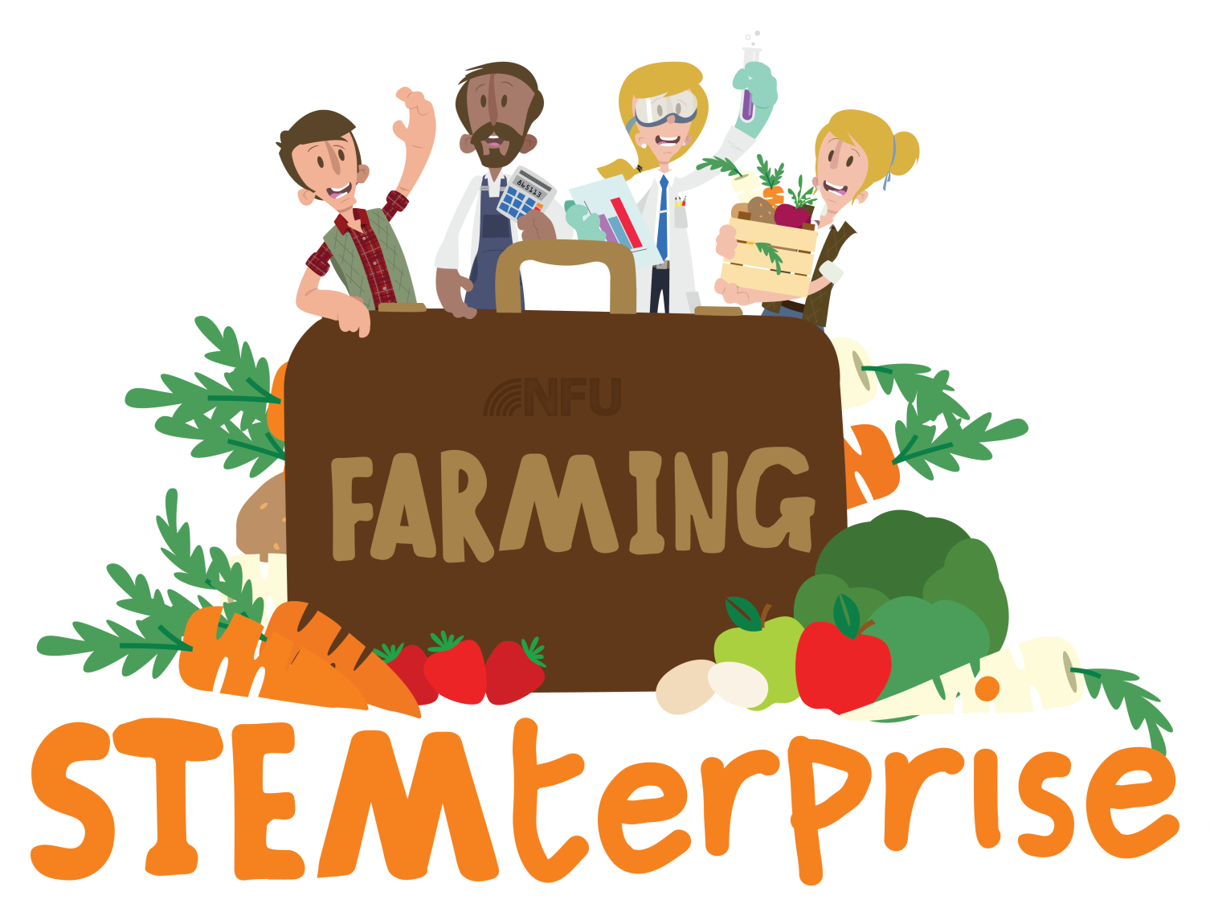
Stage 9: Promoting and packaging products

Slide 2
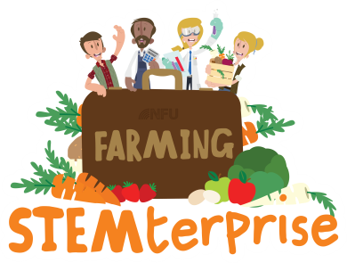
Learning Objectives:
To promote a food product
To design and make packaging
Businesses use promotion to tell possible customers all about their product.
Promotion is used to advertise the benefits of the product and why it is better than competitors.
You can use promotion to persuade customers to buy your product.
Can you think of any ways that businesses do this?

Slide 3
Methods of Promotion
Advertising: TV or magazine adverts, posters, leaflets, flyers, brochures
Special offers: price reductions, competitions, free samples
Endorsements by celebrities

Slide 4
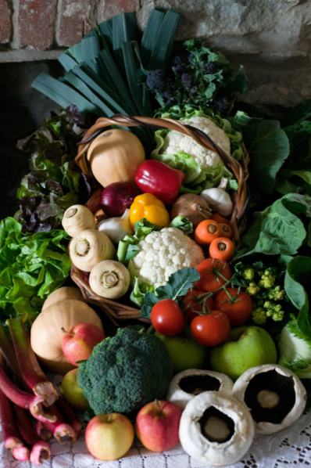
Task 1: Exploring food advertising
Look at the food advertising on your table.
How do they encourage customers to buy more of their products?
What makes you want to buy it?

Slide 5
Task 2: Promoting your product
Design a poster, flyer or leaflet to promote your product.
Think about how to appeal to your customers and persuade them to buy it.
Think about any special offers that you can use on your advert. For example, ‘Buy one, get one free’.

Slide 6
Task 3: Promoting your product
In your groups, plan and perform a television or radio advertisement for your product.
Think about how to appeal to your customers.

Slide 7
Let’s think about packaging our product
Most of food products in supermarkets come in packaging.
Some packaging can be recycled but a lot of it cannot.
Lots of our food is packaging in plastic that cannot be recycled.

Slide 8
Notes:
Plastic waste does not decay quickly. Therefore, plastic waste that ends up in the oceans is likely to remain there for decades.
There are many examples of where animals have become entangled in plastic waste such as plastic bags, bottle and discarded nylon fishing nets.

Slide 9
Notes:
In the UK, we now recycle a lot of our waste plastic. However, plastic in the form of polythene and clingfilm ends up in landfill.
Some households do not recycle waste and waste from litter bins in public places is rarely sorted for recycling.

Slide 10
Notes:
All these reasons are important.
Food is kept fresh because packaging may keep the food dry, keep microbes out or may enclose a protective atmosphere such as nitrogen gas (to stop food oxidising and to stop some microbes from multiplying).

Slide 11
Notes:
Children will be very familiar with modern packaging materials. They may be less familiar with paper, glass and tin packaging.

Slide 12
Notes:
Children will be very familiar with modern packaging materials. They may be less familiar with paper, glass and tin packaging.

Slide 13
Notes:
Reinforcement of Slide 6. This is to emphasise that plastic packaging is beneficial provided it is disposed of and processed responsibly.

Slide 14
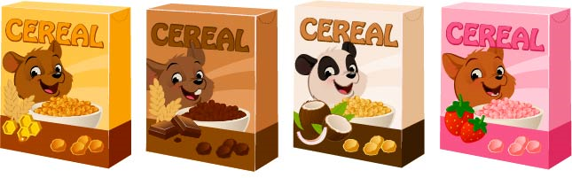
Task 4: Design your packaging
Design and make the packaging for your product.
Think about the materials you will use.
Think about how to appeal to your customers.
How will you make your product stand out from the competitors on the shelf?

